Slide 1
Module 7: Storing Data
SER 423

Slide 2
Storing Things Locally

Slide 3
Local Storage
The common way to store data locally through react is with the AsyncStorage package
  Yes, this is local and also asynchronous
  While we do not have to wait nearly as long as a network call, this could still take some time
AsyncStorage essentially stores your data as a map
This means you provide a key and a value to go with it
The key is the name you use for this particular value, both when storing and retrieving this data
We can call getItem and pass in a key to get the value stored under that key
  If the key does not exist, the result is null
In order to save information we will need to use setItem, which takes a key as well but also the data that you want stored under that key

Slide 4
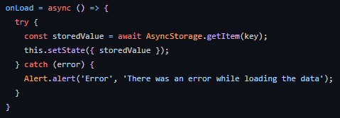
Retrieving From Local Storage

Slide 5
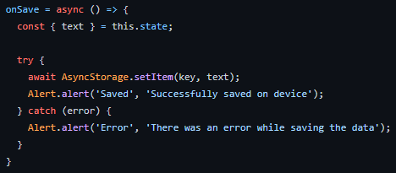
Saving to Local Storage

Slide 6
Remote Storage

Slide 7
Using Remote Storage
This is essentially making a remote API call
Loading from storage is a GET request, saving to the storage is a POST request
So, what’s new here for us to cover?
Well, how about syncing data continuously?
Essentially, whenever the user makes a change you submit a POST request
Where this becomes a problem is what if the network connection drops
In that case, we will need to save any changes the User makes and POST them after our connection is restored
Once the connection comes back, if there’s any queued changes, we can POST them then

Slide 8
Setting Up Syncing
For starters, we will need a variable in state to track whether our connection is active or not
We can then use the NetInfo package from react to determine our network state
  And we can use our lifecycle hooks to detect this immediately
From that hook, we can also register a callback to be notified when the network status changes
We then define a function that does the actual POST request
When the User makes a change we do one of two things
  If we have a connection, POST the changes
  If we don’t, create an object to hold the changes and set a flag to know there’s queued changes
We then just set this callback function to call the POST function if there are changes queued when the connection is restored

Slide 9
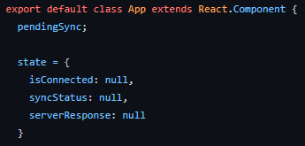
Setting Up the State

Slide 10
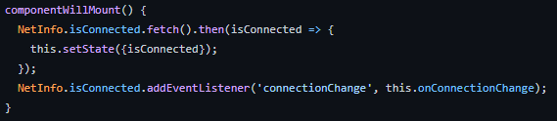
Checking for a Connection

Slide 11
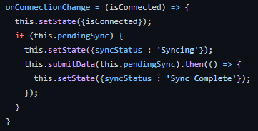
The Callback

Slide 12
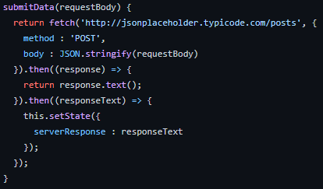
The Actual POST Function

Slide 13
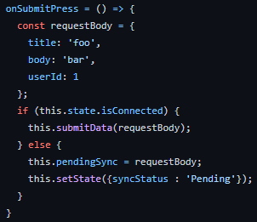
Building the Changes Object for Queueing

Slide 14
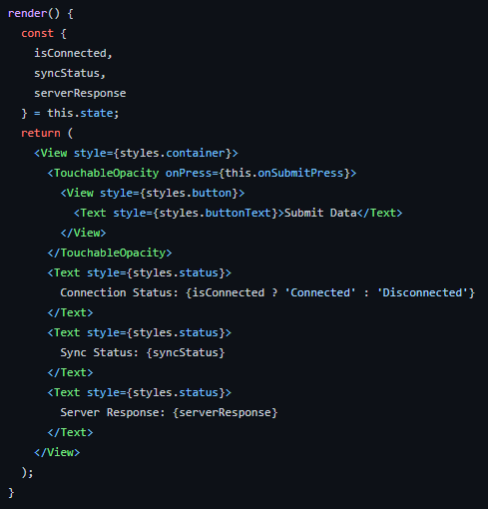
A Quick Look at Render

Slide 15
End of Storing Data
That’s it for Module 7!

